Slide 1

United nations stats webiste
Onur Akın Seyfi - 820220304
Weronika Jopek - 912400002
Duc Quang Nguyen - 150210921

Slide 2
Description
The aim of this project was to create the webiste that gathers and visualizes United Nations statistics.
From the 66th edition of The United Nations’ Statistical Yearbook, we selected 8 tables and created a subpage for each of them.
Our project uses Python for executing SQL queries and HTML, CSS and small parts of JavaScript for frontend development. We used Flask to establish the connection between Python and HTML (i.e., between server and user).

Slide 3
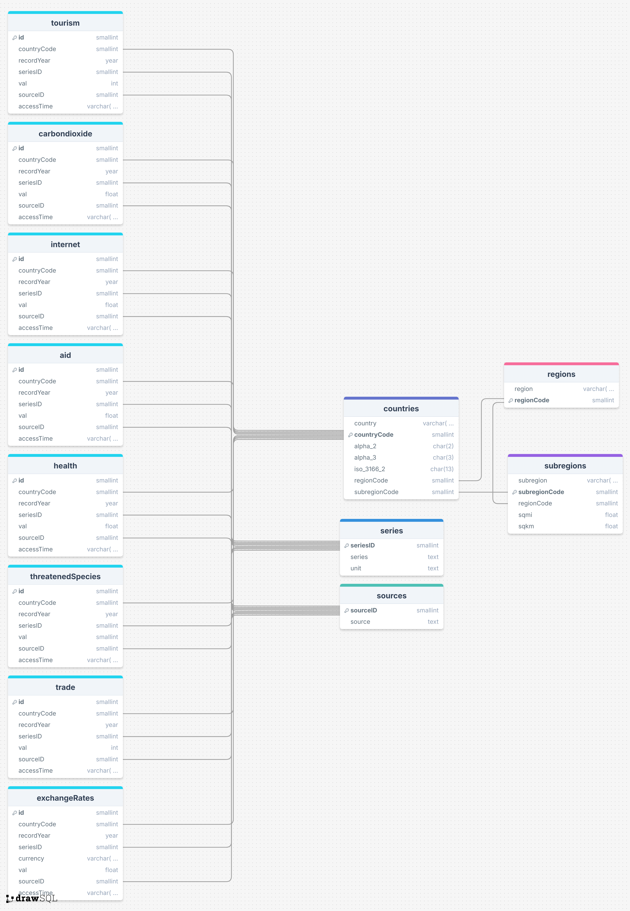

Slide 4
Dataset
Health expenditure
Exchange rate
Imports & Exports
Threatened species
CO2 emission
Internet usage
Tourism
Development aid
Countries & regions (to set country and regions as Primary Keys in each tables)
Series & Sources

Slide 5
LOGIN PAGE
To enhance the user experience and make the website more accessible, we implemented an authentication system using Flask-Login.
The website supports two types of users: admin and regular user.
Both roles can log in through the secure login page, which validates credentials stored in a mock user database.
Admin credentials allow access to all areas of the website, while regular users can explore the visualized data and subpages.

Slide 6
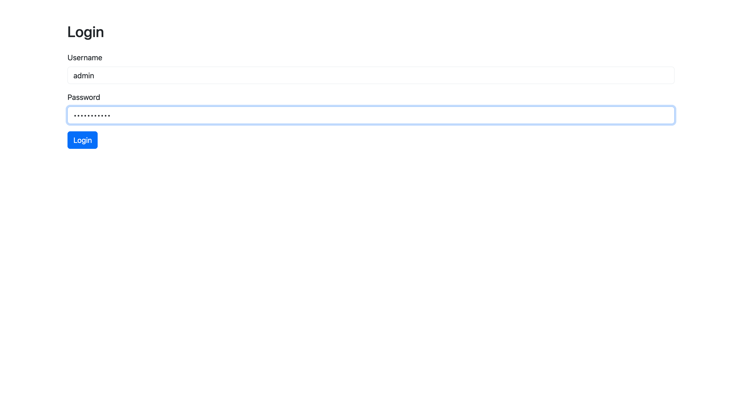
LOGIN PAGE

Slide 7
MAIN PAGE
The main page of our website serves as a welcoming hub for users to access United Nations statistical data and visualizations.
It is designed to be intuitive and user-friendly, featuring a clean layout and clear navigation options.
At the top of the page, a logout button is available, allowing users to securely end their session with a single click.
The page is divided into two main sections: Navigation Links (a list of links provides quick access to the eight subpages, each representing a specific dataset) and Image Display (related to UN).
Additionally, there is a special link to the “UN Wrapped: The World in 2020” section, where users can explore interactive charts and visualizations summarizing global statistics.

Slide 8
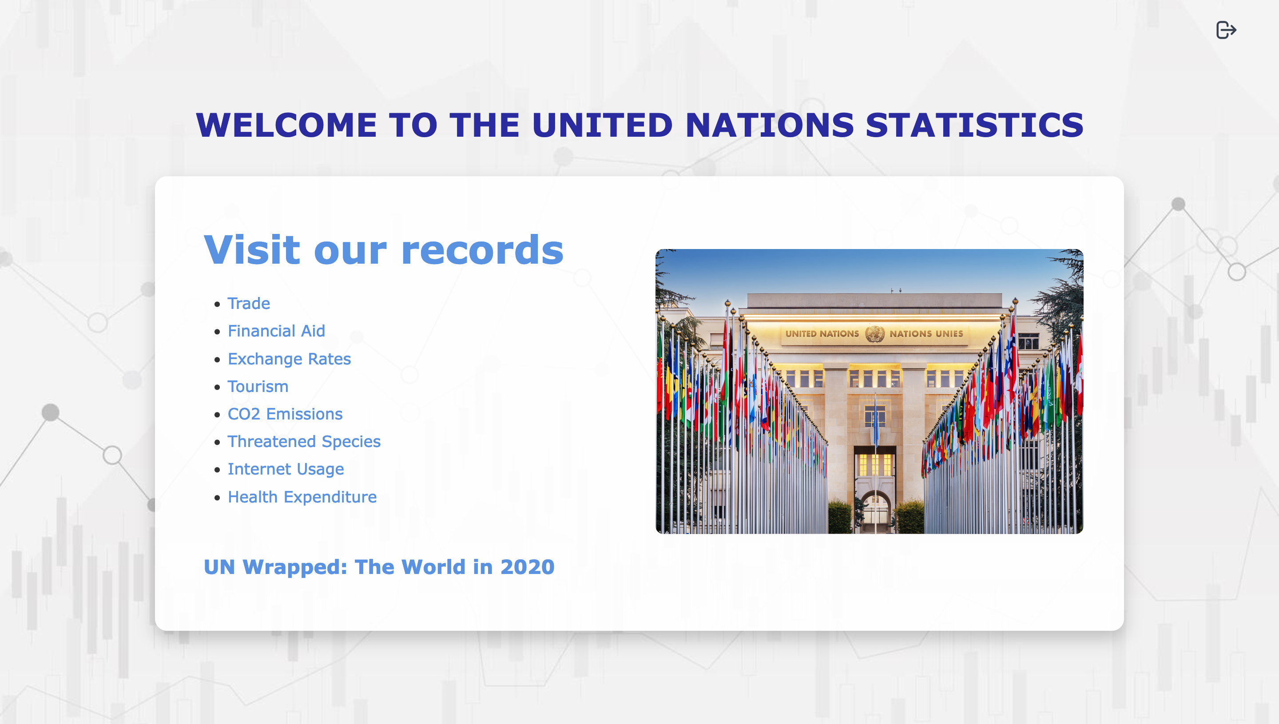
MAIN PAGE

Slide 9
SUBPAGES
Each subpage on the website displays its respective dataset in a table format for easy readability and organization.
To improve usability, we implemented pagination at the bottom of each page, allowing users to navigate through large datasets efficiently.
The navbar includes: A United Nations logo and A “Back to Main Page” button.
Admin can add new record (yellow button in navbar), edit and delete every record.
Regular users have read-only access allowing them to view the data without the ability to modify it.

Slide 10
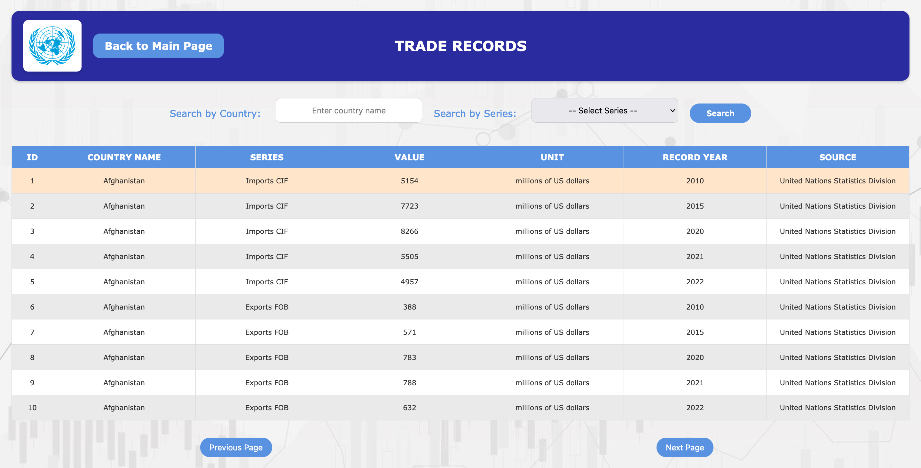
Table page – user version

Slide 11
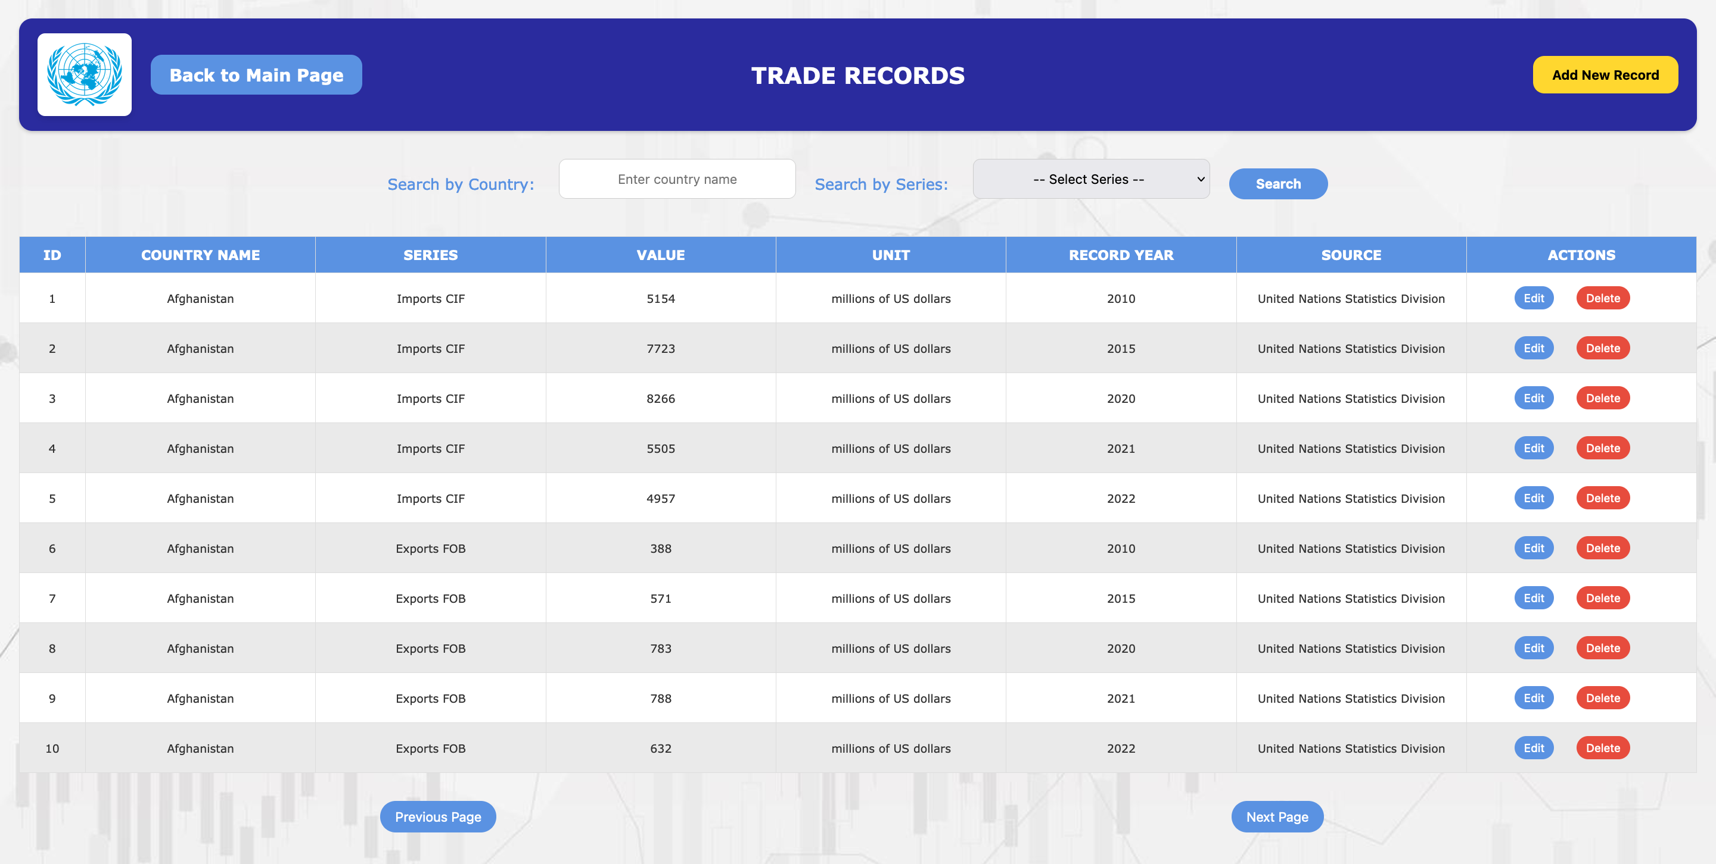
Table page – admin version

Slide 12
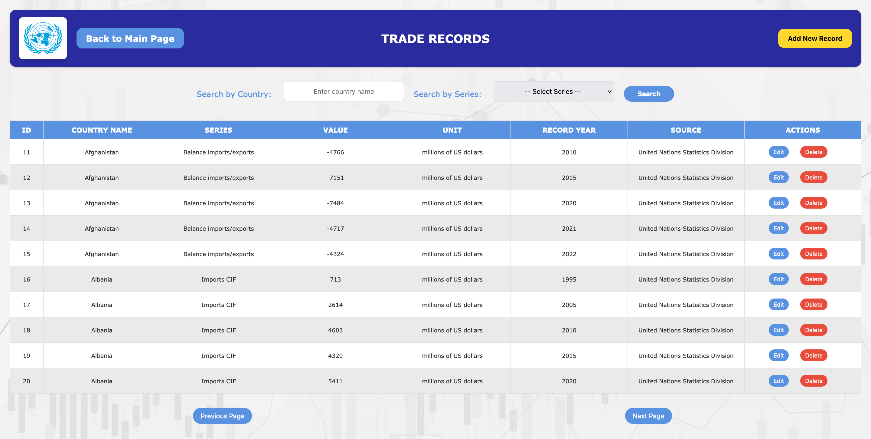
Pagination

Slide 13
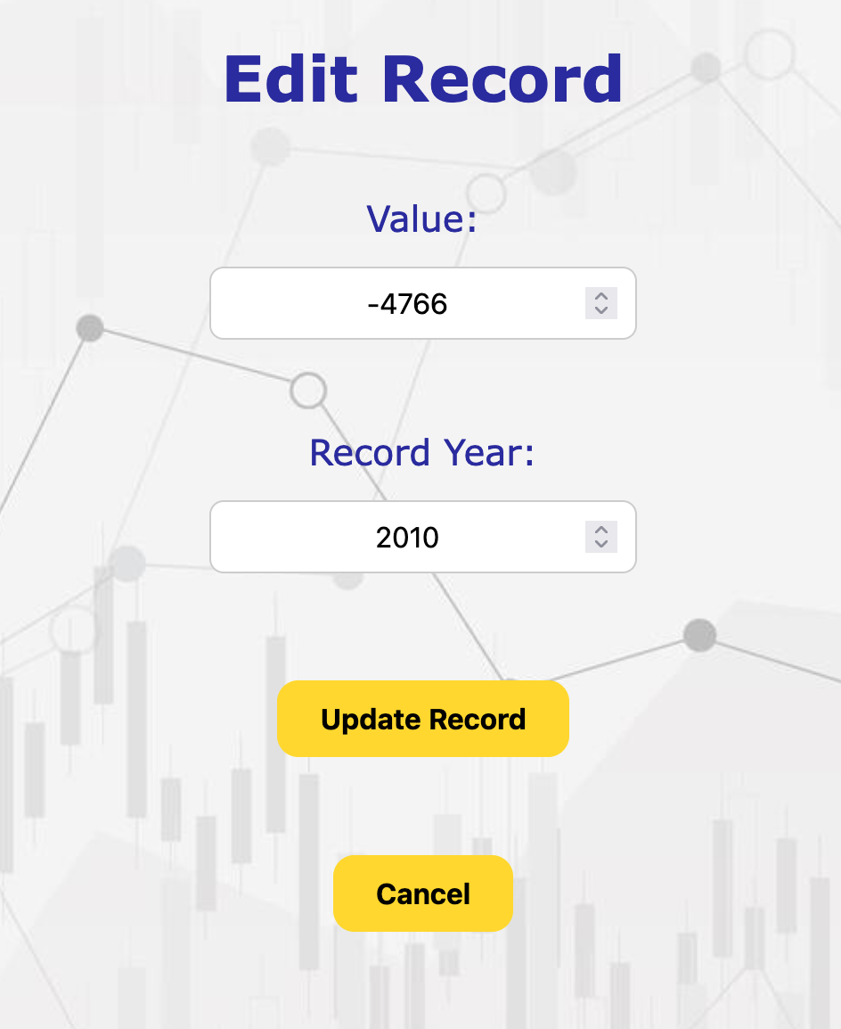
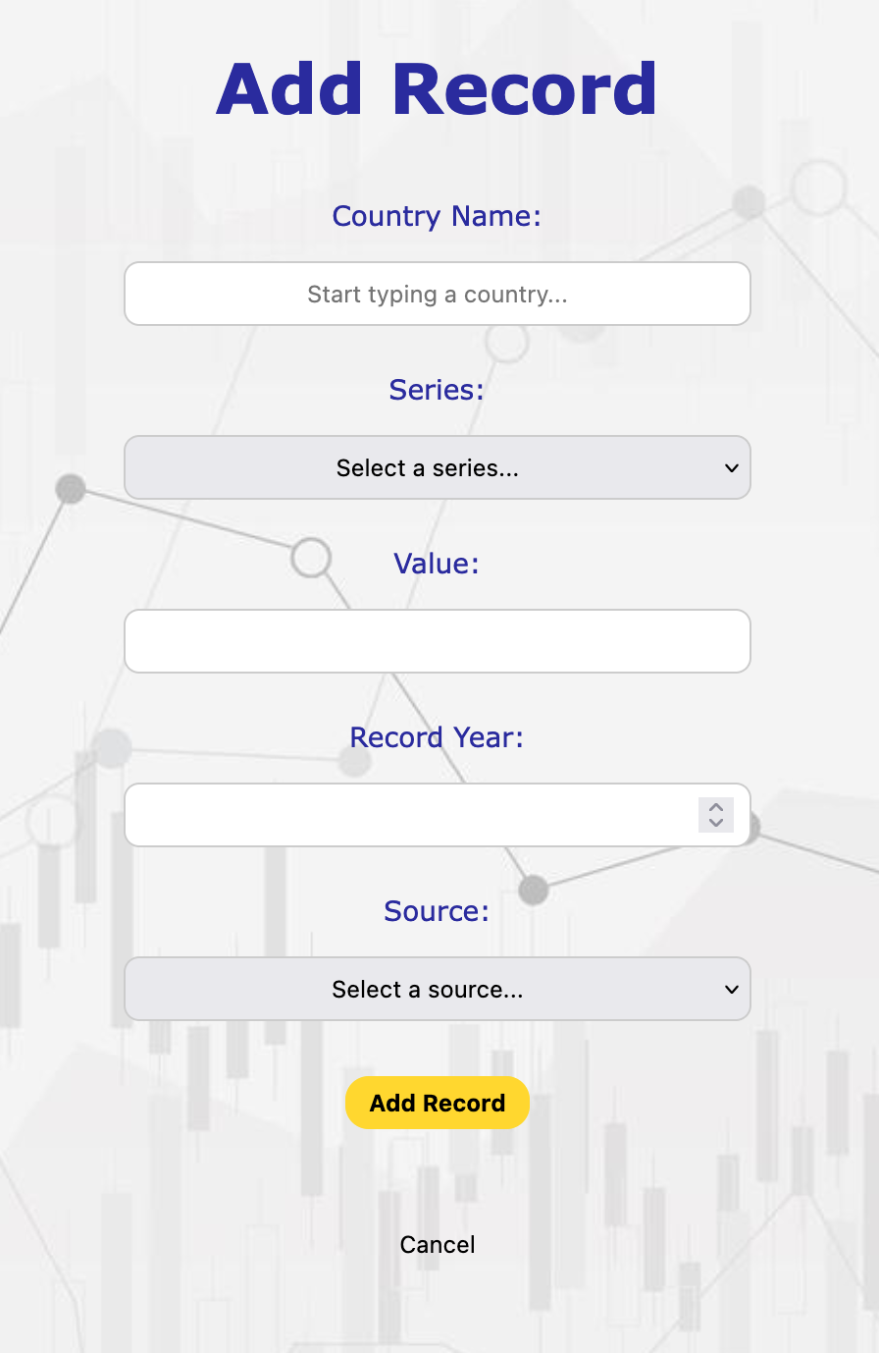
Edit Record and Add Record

Slide 14
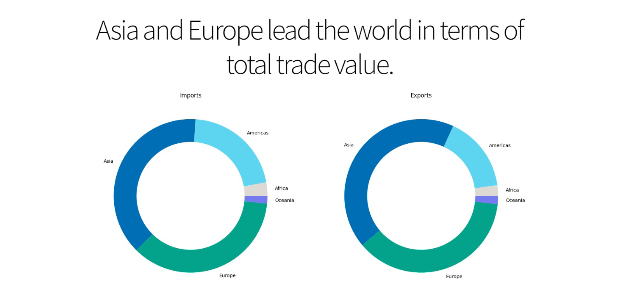
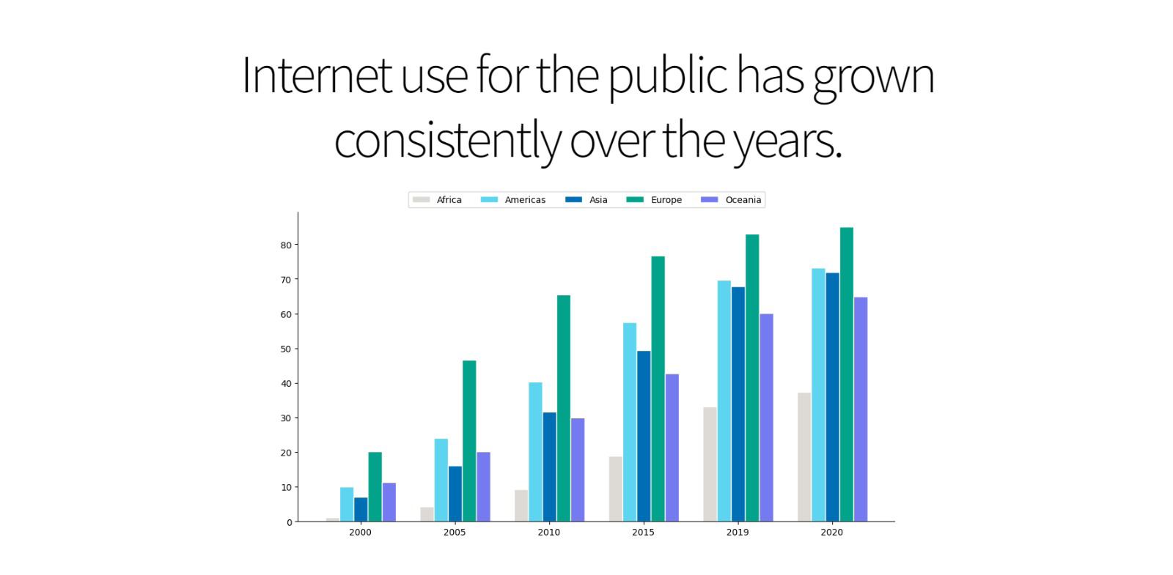
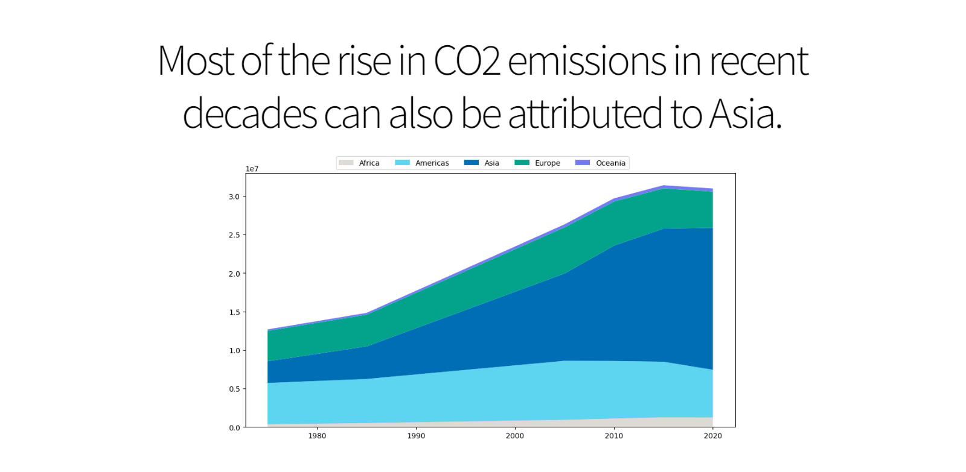
Charts

Slide 15
CHARTS
To make the website more engaging and easier to understand, we added charts and graphs
These visualizations help highlight trends and patterns in the data, making the information more accessible to users.
All the plots are made from database queries (using Python matplotlib and numpy libraries). They are not stored images.

